Slide 1

Trump’s Impact on Immigration and DEI: How to Engage in Proactive Compliance

Slide 2








Brought to you by ABC’s Strategic Partners

Slide 3



Littler Mendelson, P.C.
Presenters
Jim Paretti
Shareholder
Workplace Policy Institute
Immigration and Global
Mobility Group
jparetti@littler.Com
Maury Baskin
General Counsel
Associated Builders & Contractors
mbaskin@littler.Com
Jorge Lopez
Chair
Immigration and Global
Mobility Group
jlopez@littler.Com

Slide 4
ICE Audits, ICE Raids & Warrants – Are You ICE’s Next Target?

Slide 5
I-9 Audits by ICE/HSI
It is anticipated that Trump Administration will increase ICE I-9 audits to 12,000 a year with 100+ ICE worksite raids a year.
By comparison, Biden Administration averaged less than 500/year audits; under Bush & Obama there were 3,000-3500/year or less.
In Trump 1.0, I-9 Audits were: 5981 in FY18, 6450 in FY19; and goal of 12,000 in FY20 before COVID hit.
Audits will be ramping up soon (3-6 months).
ARE YOU READY TO SHOW COMPLIANCE?

Slide 6
You are being Targeted by ICE
The construction industry is being targeted by ICE/HSI:
  Along with hospitality, food processing, agriculture, and infrastructure.
Why are these industries targeted?
  Based on published reports, these industries appear to have most undocumented workers in workforce.

Slide 7
What is an ICE I-9 Audit?
ICE agents hand-deliver a Notice of Inspection (NOI)/ subpoena to employer’s facility;
  Possible to receive via FedEx;
NOI/subpoena demands employer produce (within 3 days):
    Forms I-9 of current & terminated employees with supporting documentation, if retained, including passport, green card, EAD, driver’s license, & any E-Verify confirmations;
    List of current employees; payroll and quarterly reports; names of owners & staffing companies; Articles of Incorporation and business licenses; and whether a participant in E-Verify.

Slide 8
Employer Protocol: I-9 Investigations
Tips:
  Ask for contact info of agent serving the NOI.
  Never waive the 3-day period.
  Sometimes, ICE will authorize an extended deadline.
  Investigator cannot take records from the workplace on their own.
Can ICE enter non-public areas of worksite? ICE must have either consent of employer or search warrant signed by federal judge for non-public areas of worksite. Even if ICE officer has an administrative warrant from DHS for arrest of an employee, the officer is only allowed in public areas of workplace.

Slide 9
Planning for ICE Inspections of I-9s
Standard policy recommendation:
  Conduct internal I-9 audit to cure errors on Form I-9.
  Ensure staff are trained on maintenance/preparation of Form I-9s.
  Address how to respond to a Notice of Inspection in an audit.
  Assemble your Crisis Management team in advance (management/senior leadership who will handle escalation in event of site investigation).
  Form a company policy/process on whether employer consents to give ICE agents right to access worksite without a warrant.
  Make sure everyone immediately informs a designated point of contact.
  Make copies of ALL documents given to ICE; obtain a receipt for records taken; get name/phone/card/badge of lead ICE agent; prepare a memo setting out what happened.

Slide 10
What is an ICE Raid?
ICE agents surround the premises and usually have aerial presence, airplane or helicopter.
ICE agents & other government agencies enter the business with a search warrant issued by a federal judge.
Search warrant will have a detailed description of what and where agents are going to search and what they may seize.
During a worksite raid, if ICE discovers unauthorized workers at the site, they will arrest, detain them, and place them in Immigration Court, or federal court if a federal crime, such as identity theft has occurred.

Slide 11
ICE Raids
From mid-2008 through 2017, ICE did not raid employers.
In April 2018, ICE raids returned & ICE detained 100+ employees at each raid:
In Trump 1.0, about 50+ raids from April 2018 to March 2020.
Employees charged w/ ID theft & arrested or to Immigration Court;

Slide 12
ICE Raids – What to Do
Contact Legal immediately;
If search warrant is presented, request copy & review what areas of the business that it gives access to and comply with ICE agents;
Object to any searches outside the scope of the warrant and ask the ICE agent to make note of the objection;
Record the names of the ICE agents;
Obtain a list of items seized in the search;

Slide 13
ICE Raids (cont’d)
DO NOT answer any questions. If you answer any questions, tell the truth.
May not tell employees not to speak to ICE nor to flee the facility.
You may tell the employees that it is their decision on whether to speak to ICE.
At no time should an ICE agent be unaccompanied in the building but DO NOT obstruct the raid;

Slide 14
Judicial Warrants vs Administrative Warrants
Judicial warrant/subpoena:
  Issued by Federal or State court:
    With a judicial warrant (for search or arrest), then you must comply with that 100%, likely immediately.
    Ensure the document was issued by a federal or state court:
      (1) signed by the judge
      (2) listing the address of the premises to be searched
      (3) that the warrant is being executed within the prescribed date/time (a DHS-issued document won’t have these limitations).

Slide 15
Administrative Warrants
The purpose of an administrative warrant is to arrest/detain an employee suspected of unlawful work.
ICE officers do not have authority to enter a non-public area of the worksite without the employer’s consent (or a judicial warrant).
The employer may choose to refuse ICE’s request to enter a non-public area of the worksite. To do so, the employer should explicitly say: “We do not consent for you to enter the non-public areas of our worksite.”
Without a judicial search warrant, employer has the right to refuse to make employees available for ICE.
However, employers generally have no control over what ICE does outside of workplace (or even in a public area such as a parking lot).

Slide 16
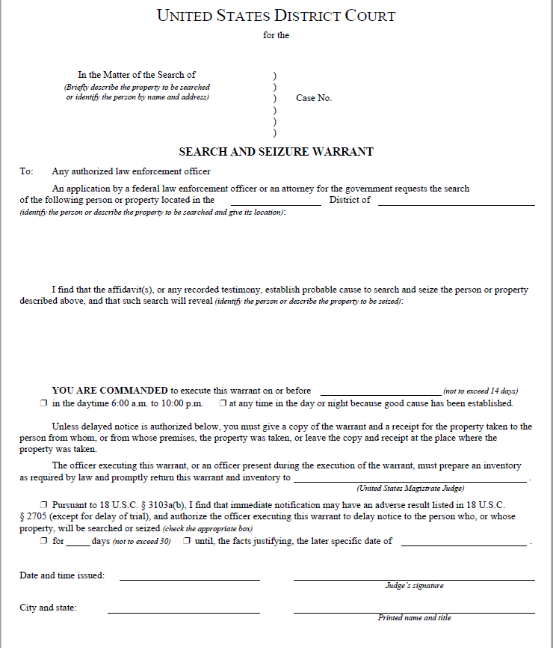
Judicial Warrant (Sample)

Slide 17
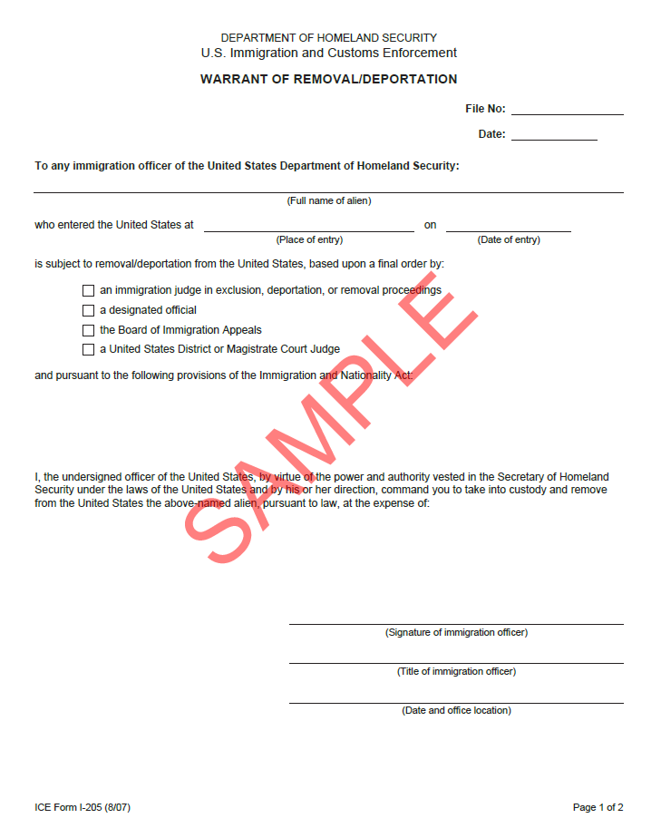
Administrative Warrant (Sample)

Slide 18
Recommended Practices for Compliance
Recommended practices for Immigration Compliance include the following:
  Establish an internal compliance and training program covering I-9 compliance;
  Maintain copies of any documents accepted as proof of identity and employment authorization with the Form I-9 for all new hires;
  Consider establishing tip line for employees to report activity that relates to the employment of unauthorized workers and create a protocol for responding to credible employee tips; and
  Ensure any contractors and subcontractors establish procedures to comply with employment eligibility verification requirements.

Slide 19
Compliance Resources
  Littler.com Immigration Compliance Checklist and FAQs
  Regulatory Roundup at: https://www.abc.org/regroundup
  ABC’s Regulatory Resource Hub on Final Rules at: https://www.abc.org/Politics-Policy/Regulatory-Resource-Hub-on-Final-Rules
  Archived Webinars at: https://www.abc.org/academy
  Newsline at: https://www.abc.org/News-Media/Newsline

Slide 20
DEI Executive Orders

Slide 21
Executive Order 14173 (January 21, 2025)
OFCCP Changes for Government Contractors
Repeals Executive Order 11246 (1965), which established affirmative action requirements for government contractors.
  DOL Memorandum (January 24, 2025). Directs all DOL employees, including employees OFCCP, Administrative Law Judges, and Administrative Review Board, instructing them to “immediately cease and desist all investigative and enforcement activity under the rescinded Executive Order 11246” and its implementing regulations.
  Affirmative Action Plans for race, ethnicity, and gender no longer required.
  Ongoing investigations suspended; employers in the midst of any compliance or enforcement activity advised to seek counsel.
  OFCCP shall require in all contracts and grant awards to include a term requiring participants to certify that they do not operate DEI programs that violate federal law, and that compliance with non-discrimination is material (raises False Claims Act concerns)
Contract amendments, modification, FARS regulations forthcoming

Slide 22
Executive Order 14173 (January 21, 2025)
OFCCP Changes for Government Contractors
Unchanged:
  Fundamental Title VII non-discrimination prohibitions
  State and local laws prohibiting discrimination on protected bases
  Obligations (including AAP plans) for disabled applicants (Section 503 of Rehab Act) and protected veteran status (Vietnam Era Veterans’ Readjustment Assistance Act)
  Self-identification of employees for EEO-1 purposes (and any requirements imposed by state law) still required until changed

Slide 23
Executive Order 14173 (January 21, 2025)
Next Steps: Private Sector
Sec. 4. Encouraging the Private Sector to End Illegal DEI Discrimination and Preferences.
The heads of all agencies, with the assistance of the Attorney General, shall take all appropriate action with respect to the operations of their agencies to advance in the private sector the policy of individual initiative, excellence, and hard work
Attorney General, within 120 days, in consultation with the heads of relevant agencies and in coordination with the Director of OMB, shall submit a report to the White House containing recommendations for enforcing Federal civil-rights laws and taking other appropriate measures to encourage the private sector to end illegal discrimination and preferences, including DEI. The report shall contain a proposed strategic enforcement plan identifying potential targets for investigation

Slide 24
Interpretive Memoranda & Guidance
Attorney General Pam Biondi Memo to all DOJ Employees (Feb. 5, 2025)
  DOJ will investigate, eliminate, and penalize illegal DEI and DEIA preferences, mandates, policies, programs, and activities in the private sector
  Civil Rights Division and Office of Legal Policy to submit a report by March 1, 2025 addressing:
    Key sectors of concern within the Department's jurisdiction; most egregious and discriminatory DEI and DEIA practitioners in each sector of concern; plan to deter the use of DEI and DEIA programs or principles that constitute illegal discrimination or preferences, including proposals for criminal investigations and for up to nine potential civil compliance investigations
But see “Multi-State Guidance Concerning Diversity, Equity, Inclusion, and Accessibility Employment Initiatives” (February 13, 2025). Sixteen* state attorneys general “to help businesses, nonprofits, and other organizations operating in our respective states understand the continued viability of [DEI] efforts.”
  * Massachusetts, Illinois, Arizona, California, Connecticut, Delaware, Hawaii, Maine, Maryland, Minnesota, Nevada,
  New Jersey, New York, Oregon, Rhode Island, Vermont

Slide 25
Interpretive Memoranda & Guidance
OPM Guidance (Feb. 5, 2025)
  Applicable only to federal sector (not government contractors)
  Prohibits unlawful discrimination in any employment action or other term, condition, or privilege of employment, including but not limited to recruiting, interviewing, hiring, training or other professional development, internships, fellowships, promotion, retention, discipline, and separation, based on protected characteristics
  Unlawful discrimination related to DEI includes taking action motivated, in whole or in part, by protected characteristics. Among other practices, this includes ending unlawful diversity requirements for the composition of hiring panels, as well as for the composition of candidate pools (also referred to as “diverse slate” policies).
But see “Multi-State Guidance Concerning Diversity, Equity, Inclusion, and Accessibility Employment Initiatives” (February 13, 2025). Sixteen* state attorneys general “to help businesses, nonprofits, and other organizations operating in our respective states understand the continued viability of [DEI] efforts.”
  * Massachusetts, Illinois, Arizona, California, Connecticut, Delaware, Hawaii, Maine, Maryland, Minnesota, Nevada,
  New Jersey, New York, Oregon, Rhode Island, Vermont

Slide 26
EEOC Acting Chair Statement
Acting Chair Andrea Lucas (R):
  “My priorities will include rooting out unlawful DEI-motivated race and sex discrimination; protecting American workers from anti-American national origin discrimination; defending the biological and binary reality of sex and related rights, including women’s rights to single‑sex spaces at work; protecting workers from religious bias and harassment, including antisemitism; and remedying other areas of recent under-enforcement.”
Commission currently lacks quorum; policy changes will not come until it has at least three seated members
Even absent quorum, expect vigorous enforcement of “reverse discrimination” claims that target DEI
Supreme Court poised to decide whether “reverse discrimination” claims are subject to a higher burden of proof

Slide 27
Recommendations
Nuance, language, and details matter; consult with counsel
Guidance limited, and definitions can be circular: “illegal DEI is unlawful”
Examine DEI programs and initiatives to ensure compliance
    DEI page on Intranet/Extranet website
    Job posting language regarding DEI and equal opportunity
    Diverse candidate or interview panel policies
    Mentorship, internship, scholarship programs
    Leadership development and training programs
    Employee Resource Groups (ERGs) and heritage month programs
    Key Performance Indicators (KPIs) or compensation structure incorporating DEI
    Voluntary self-identification of demographic information and its use in DEI programming

Slide 28
FAQs
I’m a government contractor. Do I have to file utilization reports with OFCCP any more? Apparently not, but awaiting further guidance
I’m a private contractor. How do I tell whether a diversity program is legal or illegal? Awaiting further guidance, but the Administration has focused on programs that give any group an advantage over other groups based on “protected” characteristics.
Are we supposed to erase words like “diversity” and “equity” from our documents? Erasing these terms does not appear to be legally required, but “inclusivity” and “merit appear to be safer. Focus on defining the terms to avoid discriminatory affirmative action (not yet fully defined)
I’m based in a state that has its own DEI requirements, in conflict with the new federal executive orders. Which rules govern? Unclear at this time. Awaiting further guidance

Slide 30
Brought to you by ABC’s Strategic Partners

